Slide 1
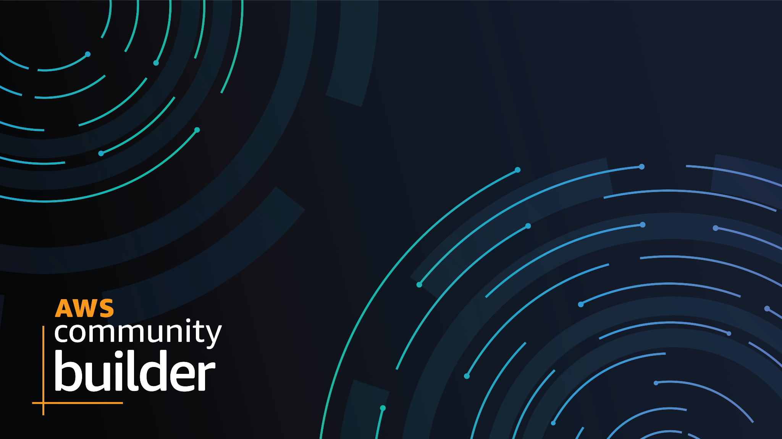
How to apply for AWS Community Builder Program?
Shaista Aman - Pakistan CB Q1 2022
Dipak Poudal - Nepal CB Q1 2022

Slide 2

Shaista Aman
AWS Community Builder Pakistan
Seasonal freelancer & technology evangelist.
Founder of EzzyApp
CEO of 3C – Creators Cloud Club
AWS Community Builder
1x AWS | 6x Alibaba Cloud certified
AWS Serverless Development & Deployment
https://www.linkedin.com/in/shaista-aman/
Notes:
I’m a seasonal freelancer and technology evangelist. She is founder of EzzyApp and CEO of 3C – Creators Cloud Club. Apart from her years of experience in telecom and software sectors on different projects, she has keen desire of learning advance technologies.

Slide 3
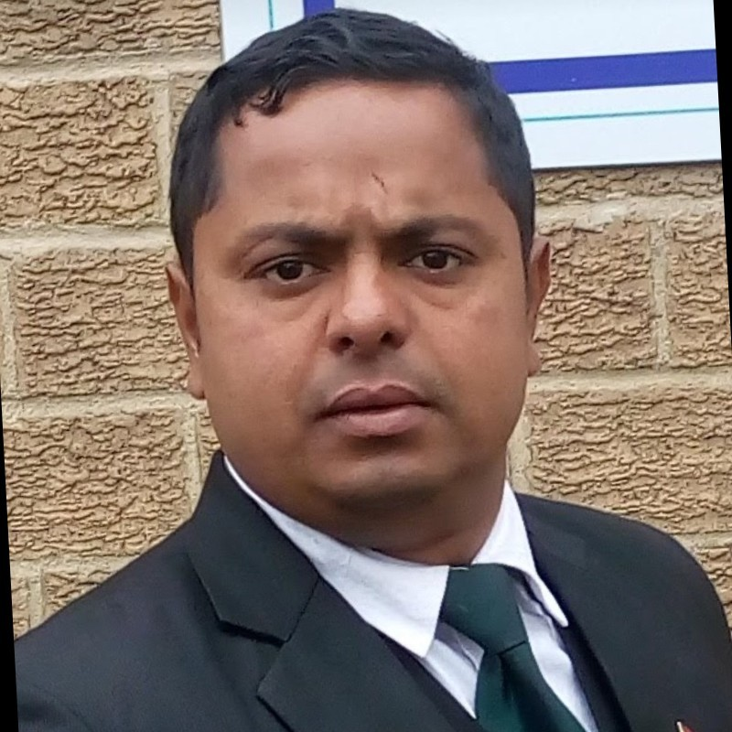
Dipak Poudel
AWS Community Builder Nepal
Senior Solution Architect at Genese Solution
AWS Academy Accredited Trainer
AWS Community Builder
AWS Academy Certified Educator
https://www.linkedin.com/in/poudeld/
Notes:
I’m a seasonal freelancer and technology evangelist. She is founder of EzzyApp and CEO of 3C – Creators Cloud Club. Apart from her years of experience in telecom and software sectors on different projects, she has keen desire of learning advance technologies.

Slide 4
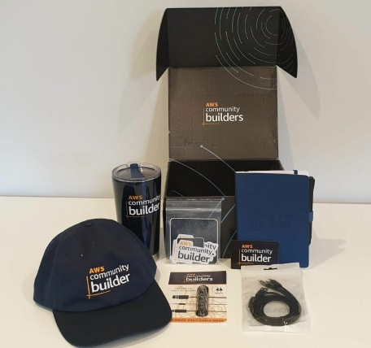
What is AWS Community Builder Program?
The AWS Community Builders Program(CB) is a officially organized by AWS.
The program supports AWS enthusiasts and other community members by providing:
Technical mentorship
Exclusive networking opportunities
Virtual speak events
Notes:
https://bit.ly/CB2022July

Slide 5
Criteria
Any individual who is 18 years or older and passionate about building on AWS.
AWS Community Builders program seeks applicants from all regions, demographics, and underrepresented communities.
The AWS Community Builders program is for technical builders who create community contributions such as written/video content (blog posts, videos, webinars, tutorials, etc.) or organize technical communities that help other AWS builders to learn and build on AWS.
Notes:
https://dev.to/aws-builders/how-to-become-an-aws-community-builder-2m79?mkt_tok=MTEyLVRaTS03NjYAAAGFWNX7FXFoHsiWj-t3nSTnmjo4MOHodKwkM5hUW6-uJAvAmWxSfJpMxiXVEWavnB-FWUf-kYEdPrVqOBj572W3e-z3yx7pcPM0YZtwVH3h65YWKpqHuLVl

Slide 6
Categories:
Machine Learning
Mobile and Web Apps
Storage
Containers
Developer Tools
Management, Governance and Migration
Serverless
Gravitron / Arm Development
Data (Databases, Analytics, Blockchain)
Security, Identity & Compliance
Game Tech
Networking and Content Delivery

Slide 7
What you will get after becoming a CB?
AWS community builder branded Swag!
AWS Promotional Credits
Online training provider
Certification Exam Voucher
Study Groups / Community help
Mentoring / Coaching / Career Opportunities
Event Exclusives
AWS Service Previews
Community Builder Dev.to Organization
3rd Party Benefits
You learn and make friends along the way

Slide 8
Live Application
Demo

Slide 9
Thank You
Any Questions?

